Slide 1
Lesson 4 FPGA I/O
Introduction
Configuring FPGA I/O
I/O Types
Integer Math
Fixed-Point Math
CompactRIO
Error Handling
Notes:
Lesson Objectives:
Add/Remove I/O from project.
Use I/O node on block diagram to read/write to I/O.
Identify situations where error handling is appropriate.
Access digital I/O from either line or port.
For R Series devices
Know that most scaling happens on the host
Know that analog I/O is of the integer data type.
Know that there is an optimization trade-off between divide and power of 2 operations on FPGA.
For CompactRIO devices
Use LabVIEW to learn about module-specific methods, properties, and timing.
Know that analog I/O is of the fixed-point data type.
Understand the fixed-point data type and how to perform arithmetic operations.

Slide 2

A. Introduction
FPGA I/O items connect I/O to the FPGA logic
Each FPGA I/O item has a type like analog or digital
FPGA VIs can have multiple types of I/O items
In the NI Example Finder, navigate to:
Toolkits and Modules»FPGA»CompactRIO»Basic IO

Slide 3
FPGA I/O Terminology
Terminal – a hardware connection, such as on a CompactRIO module
I/O Resource – a logical representation in LabVIEW FPGA of a hardware terminal
I/O Name – a name assigned in the LabVIEW project to a particular I/O Resource

Slide 4
B. Configuring FPGA I/O
Adding FPGA I/O to the LabVIEW project
If using CompactRIO, detect modules when you add your chassis.
All FPGA I/O added automatically
If using R Series, manually add FPGA I/O
Select which FPGA I/O channels you want to add
Notes:
Some developers find it simpler to see all available channels at all times; whereas other develops prefer to only have the project contain the channels necessary for their application. Neither method creates more efficient code than the other, so using or not using all FPGA I/O channels is a matter of preference.
You can also use the FPGA Project Wizard to create your project. In this case, all FPGA I/O is added automatically.

Slide 5
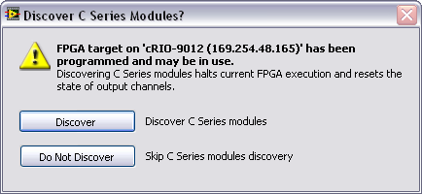
Adding FPGA I/O to a CompactRIO Project
Notes:
After you select to add an Existing Target for a CompactRIO target from the Add Targets and Devices dialog, you will be prompted with the Discover C Series Modules? dialog. Selecting Discover will halt any current FPGA execution and then add ALL the channels in all the modules. If you do not want to halt your current execution or you do not want to add all the channels in all the modules, select Do Not Discover. You can manually add each module and channel to your Real-Time project.

Slide 6
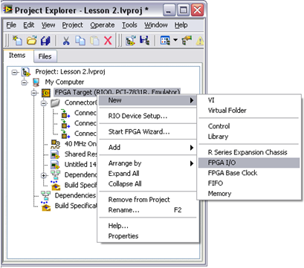
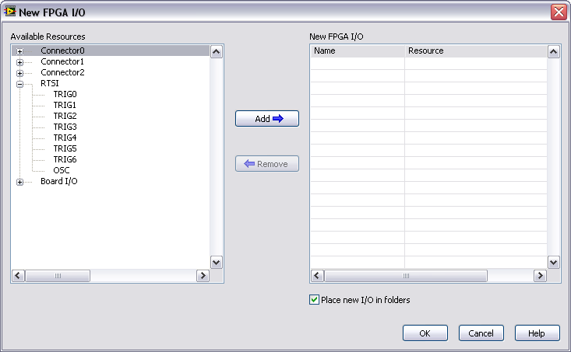
Adding FPGA I/O to an R Series Project
Notes:
To manually add FPGA I/O to your project:
Right-click the FPGA target from the Project Explorer and select New»FPGA I/O to launch the New FPGA I/O dialog box.
Select I/O in the left pane of the New FPGA I/O dialog box
Click right arrow button to add the I/O to the project.
You can name your I/O by clicking the default name and entering a meaningful name for your application.
Click OK to add the I/O to the project.

Slide 7
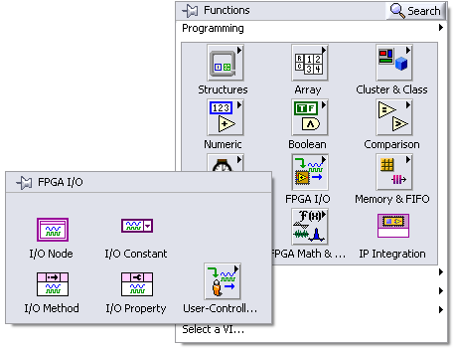
FPGA I/O Palettes
Notes:
The FPGA I/O palette includes the following functions for configuring the I/O hardware.
FPGA I/O Node—Reads or writes data from or to the FPGA I/O.
FPGA I/O Constant—Specifies an FPGA I/O item on the block diagram.
FPGA I/O Method Node—Invokes an I/O method for a specific channel or C Series module.
FPGA I/O Property Node—Reads or sets property attributes of a specific channel or C Series module.

Slide 8
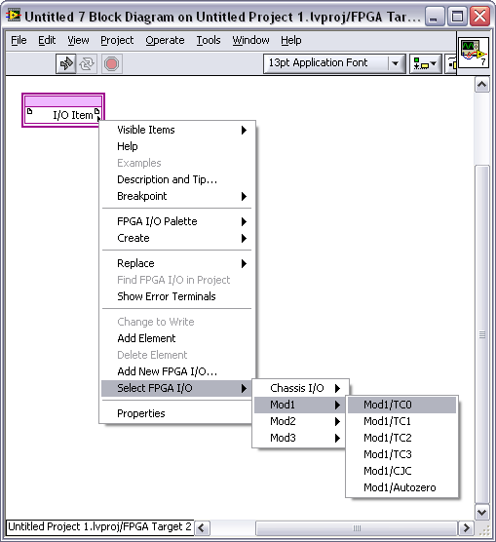
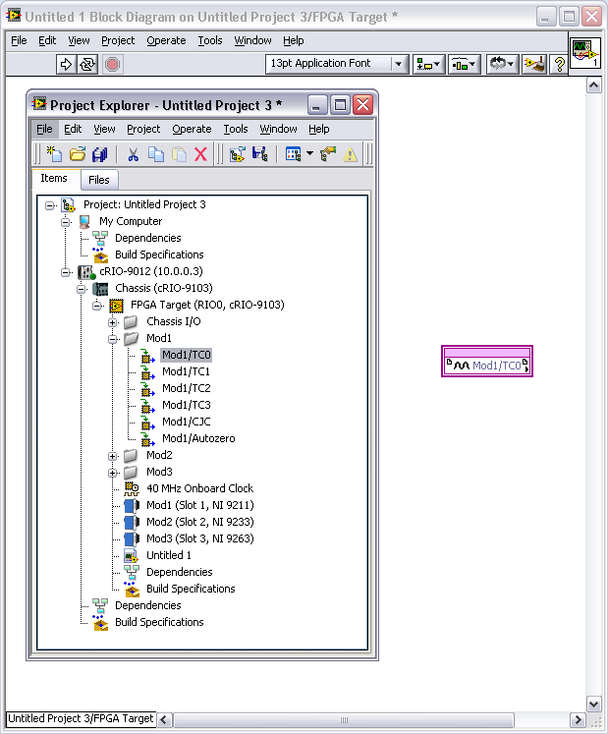
Placing I/O Nodes

Slide 9




C. I/O Types
Digital Line – Writes and/or reads Boolean value to/from digital line
Digital Port – Writes and/or reads unsigned integer value to/from digital port (grouping of digital lines)
Analog I/O – Writes or reads data to/from an analog channel
R Series – Integer values
CompactRIO – Fixed-point values (can revert to integer)
Other
Motion
CAN

Slide 10

Digital I/O
Individual Lines – Boolean data type
Ports (collection of lines) – Integer data type (1 bit per line)
Depending on your hardware, digital I/O can be unidirectional or bidirectional
If the digital I/O line or port is bidirectional and you want to change direction of the line or the port from the FPGA VI, use the I/O Method Node, and select Set Output Enable method.
Notes:
The data type of the digital port will depend on the number of lines in the port.
Some CompactRIO modules are unidirectional and others are bidirectional. Refer to the hardware manual for the capabilities of specific modules.
Refer students to Digital Line Input and Output – cRIO example in the NI Example Finder.

Slide 11
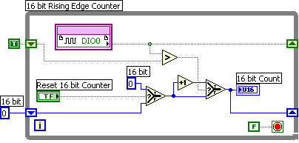
Creating Counters from Digital I/O
FPGA does not have built-in counter hardware
Can be programmed into the FPGA
Minimum input pulse width detectable depends on loop period and hardware
On some hardware, you can get improved performance by replacing the While Loop with a Timed Loop.
Notes:
The example above has the following specifications:
About 10 ticks per iteration
250 ns to guarantee a high or low read
500 ns period = 2 MHz signals.
It can read a signal at a maximum of 2 MHz. It is important to benchmark your counter before using it in a final application. We’ll discuss benchmarking more in Lesson 5.
Refer to Toolkits and Modules»FPGA»Compact RIO/R Series» FPGA Fundamentals»Counters in the NI Example Finder for related examples.

Slide 12
Analog I/O
Different devices have different default data types for analog I/O
Signed integer (R Series Devices)
16-bit or 32-bit depending on the device
Data is raw (calibrated and unscaled)
Fixed-point data (CompactRIO modules)
Data is calibrated
Floating-point operations are ordinarily not performed in the FPGA
Use the host for floating-point analysis instead
Notes:
Because the FPGA requires fixed gates to be created for its logical pathways it cannot handle data with floating mantissa and exponent data. If you need to perform floating-point analysis it is typically simplest to offload those calculations to the host for processing.
However, not all calculations can or should be offloaded to the host. Therefore if you wish to perform calculations with the FPGA VI then all of those calculations will have to be done with Integer Math or Fixed-Point Math.

Slide 13
D. Integer Math
Analog Input
Converts binary representation of the voltage to a signed integer
Pass this raw, unscaled data to the host VI for conversion to Volts or other units
Analog Output
Convert value in Volts to binary representation in the host VI
Write the binary representation of the voltage to the D/A converter
Notes:
For example, an analog module may acquire voltage values that can range from -10 to 10V. The data type of an I/O node for that module may be an unsigned long (U32), meaning that the data read would range from 0 to 4,294,967,295, with -10V corresponding to 0 and 10V corresponding to 4,294,967,295. This unscaled integer data is referred to as the binary representation of the voltage value.
Conversion to/from the binary representation should occur in the RT or Windows host VI.

Slide 14
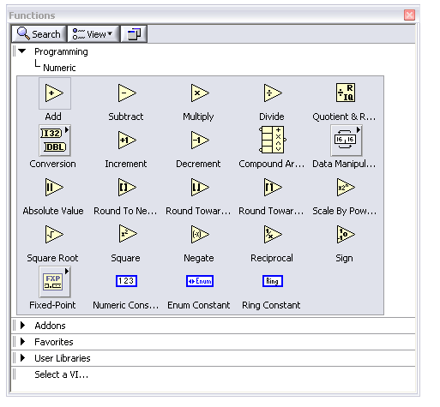
Numeric Palette
Most basic numeric functions can be used on the FPGA target
Calculations can be performed with integers and fixed-point numbers

Slide 15
Integer Division
Divide function cannot return an integer value, so you must use other functions for integer math.
Scale by Power of 2
Quotient & Remainder
Notes:
Recall the discussion of these functions in the Optimization section of Lesson 3 FPGA Programming Basics. Selection of function to use should be based upon size and speed factors.

Slide 16
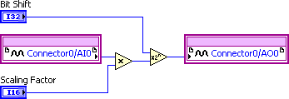
R Series Scaling in LabVIEW FPGA
For variable scaling, you can determine and set the scaling factor and n from the host application.
To multiply the data from AI0 by 0.7 we could use:
Scaling Factor: 11500 Bit Shift: –14 bits Resulting Multiplication: 11500 / 2^14 = 0.7019
Notes:
There are some ways to manipulate integer math functions so that you can create “floating-point” operations. The most common techniques use the Scale By Power of 2 function which essentially multiplies or divides by any power of 2.
This figure above shows an example of scaling data in LabVIEW FPGA. We want to be able to scale the data by .70. To get this scaling very close we multiply the analog input by a scaling factor of 11500 then divide it by 16384 (use the Scale by the Power of 2 function to the –14th power). Additionally, you can divide numbers using the quotient and remainder function, however, this can use many slices when implemented.

Slide 17
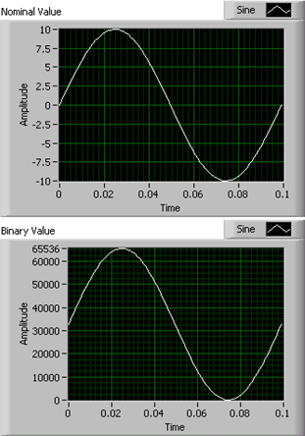
Converting Binary Representations
R Series FPGA I/O Node:
Returns a binary representation of the voltage input
Value is signed integer
Convert value to a physical quantity with engineering units
Conversion occurs in the Host VI because FPGA does not support floating-point math

Slide 18
Converting Binary Representations (cont.)
Conversion is hardware dependent
Hardware-specific factors used in conversion
Voltage Range
ADC Resolution
Offset
CJC Value
Autozero Value
Notes:
Conversion to Binary Representation is hardware dependent. Each hardware target has its own specific voltage range, analog to digital converter precision, offset and autozero values. By looking at the Help documentation for the device that you are using, you can find these hardware-specific values and use the values for conversion of the binary data on the host.

Slide 19
Exercise 4-1 R Series I/O
Use I/O in LabVIEW FPGA to acquire analog and digital data from a simulated R Series device.
Notes:
Prep discussion:
The students are going to create a new project with a PCI-7831R as the FPGA target.
They will create a new VI that acquires both analog and digital data from Connector0.
They will add specific I/O resources to the project to keep the Project Explorer window from becoming cluttered.
They will rename the I/O resources that they are using to have more meaningful names.
They will use a while loop to acquire data continuously.
They will convert the integer value read from the digital port into an array of Boolean values.

Slide 20
Exercise 4-1 R Series I/O
How many I/O nodes did you have to place on the block diagram?
What is the value of renaming your I/O resources?
What is the value of the I/O node returning data from the digital port as a U8?
Notes:
The students only had to place one I/O node on the block diagram, but they were able to obtain data from two different I/O resources, one analog and one digital.
If the student is working on a VI with MANY I/O resources coming out of a single node or if they have multiple I/O nodes for different devices, then it can quickly become confusing to understand which resources are carrying what data. Using unique names for each I/O resource will help to distinguish them and make the block diagram more readable.
The I/O resource bitpacks the digital data into a U8 to conserve space and allow the user to work with the integer data type. In order to obtain data from an individual line within the port, you can convert the integer into a Boolean array and use the array functions to manipulate the data as necessary.

Slide 21
E. Fixed-Point Math
Greatly simplifies arithmetic on the FPGA
Simplifies computations
Size and speed advantages of integer math
Must configure the appropriate range when using fixed-point math
Limited to a maximum size of 64 bits.
Notes:
The fixed-point data type provides some of the flexibility of the floating-point data type but also maintains the size and speed advantages of integer arithmetic. By default, each operation on the fixed-point data type generates a fixed-point result that is large enough to hold all possible output values specified by the input types.
Note: FPGA Signal Generation VIs and some functions do not support the fixed-point data type.
Caution: If you wire a fixed-point number to an integer, you might lose fractional bits.

Slide 22
Fixed Point Data Types
Fixed-point is a collection of data types with different ranges of values
Range is defined by minimum value, maximum value and delta
Range of values and resolution are dependent upon three factors
Sign Encoding
Word Length
Integer Word Length
Notes:
Range – Defined by maximum and minimum values that can be represented
Delta – Smallest change in value that can be represented with the given fixed-point configuration.

Slide 23
Fixed Point Terminology
Sign Encoding – The option that determines whether the fixed-point data is signed (±) or unsigned (+)
Word Length – The total number of bits used for the Fixed-Point data
Integer Word Length – The number of bits used in the integer portion of the Fixed-Point data

Slide 24
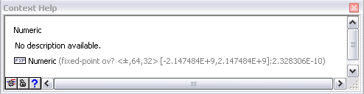
Fixed-Point Context Help
Overflow Status
Sign Encoding
Delta
Word Length
Maximum
Integer Word Length
Minimum
Notes:
Overflow Status—Shown when Include Overflow Status. checkbox is enabled in Numeric Properties dialog. To determine whether overflow occurs, you can configure a fixed-point number to include an overflow status. When you include an overflow status in a fixed-point number, LabVIEW allocates additional storage space to track whether the fixed-point number is the result of an operatio that overflowed. After you configure a fixed-point number to include an overflow status, you can display an overflow status LED on fixed-point controls, constants, and indicators. This LED lights up when the overflow status of the fixed-point number is TRUE. You also can use the Fixed-Point Overflow? function to determine the overflow status of a fixed-point number. Use the Fixed-Point functions to manipulate the overflow status of a fixed-point number.
Sign Encoding—The setting that specifies whether the fixed-point value is signed or unsigned. If you select signed, the sign bit is always the first bit in the bit string that represents the data.
Word length—The total number of bits in the bit string that LabVIEW uses to represent all possible values of the fixed-point data. LabVIEW accepts a maximum word length of 64 bits. Certain targets might limit data to smaller word lengths. If you open a VI on a target and the VI contains fixed-point data with larger word lengths than the target can accept, the VI contains broken wires. Refer to the documentation for a target to determine the maximum word length the target accepts.
Integer word length—The number of integer bits in the bit string that LabVIEW uses to represent all possible values of the fixed-point data, or, given an initial position to the left or right of the most significant bit, the number of bits to shift the binary point to reach the most significant bit. The integer word length can be larger than the word length, and can be positive or negative.
Minimum – Minimum value that can be represented
Maximum – Maximum value that can be represented
Delta – Smallest change in value that can be represented

Slide 25
Numeric Representation Examples
Representation | delta | Min Value | Max Value
U8 | 1 | 0 | 255
I8 | 1 | -128 | 127
FXP <+,8,7> | 0.5 | 0 | 127.5
FXP <+,8,6> | 0.25 | 0 | 63.75
FXP <±,8,7> | 0.5 | -64 | 63.5
FXP <±,8,6> | 0.25 | -32 | 31.75
FXP <+,8,0> | 0.0039 | 0 | 0.9961
Notes:
The integer word length can be negative as well as positive. Any integer word length less than 1 will result in a decimal maximum value. This amounts to the entire word occurring to the right of the decimal point. As the integer word length becomes more negative, zeroes are used to pad the increasing distance between the fixed-point data and the decimal point. For example, <±,6,-2> would result in 0.00XXXXXX, where the X’s represent data stored in the 6-bit word.
If the integer word length is greater than the word length, then the fixed-point data will move to the left of the decimal point, with zeroes padding the distance between the integer word and the decimal point. For example, <±, 6, 8> would result in XXXXXX00.0, where the X’s represent the data stored in the 6-bit word.
Walk the students through a few of these calculations. This is a good time to move to a whiteboard.
FXP <+,X,Y>
Maximum = 2^{Y} – 1/(2^{(X-Y)})
Minimum = 0
FXP <±,X,Y>
Maximum = 2^{Y-1} – 1/(2^{(X-Y)})
Minimum = -2^{Y-1}
Examples:
FXP <+,8,6>
Maximum: 2⁶ – 1/(2⁽⁸⁻⁶⁾) = 64 – ¼ = 63.75
or
111111.11 = 2⁵+2⁴+2³+2²+2¹+2⁰+2⁻¹+2⁻² = 32+16+8+4+2+1+0.5+0.25 = 63.75
FXP <±,8,6>
Maximum = 2⁶⁻¹ – 1/(2⁽⁸⁻⁶⁾) = 31.75
Minimum = -2⁶⁻¹ = -32
FXP <±,6,-2>
Maximum = 2⁻²⁻¹ – 1/(2⁽⁶⁺²⁾) = 0.12109375
Minimum = -2⁻²⁻¹ = -0.125
FXP <±,6,8>
Maximum = 2⁸⁻¹ – 1/(2⁽⁻²⁾) = 124
Minimum = -2⁸⁻¹ = -128

Slide 26
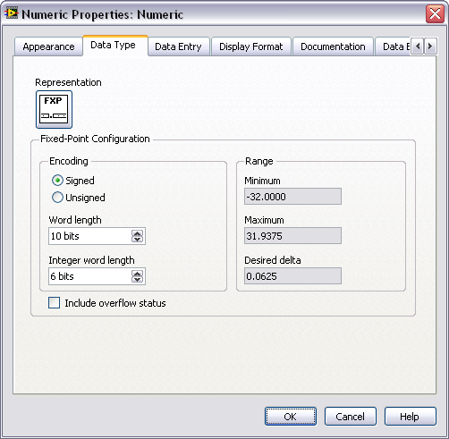
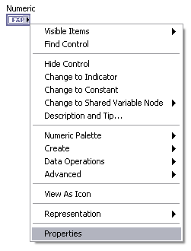
Fixed Point Configuration
Notes:
Use the Fixed Point Configuration options on the Properties dialog box to increase or decrease the resources a function uses. Right-click a numeric constant, control, indicator, or function that accepts fixed-point data and select Properties from the shortcut menu to display the Properties dialog box. When you set the range on inputs, the FPGA Module propagates the range throughout the block diagram. The propagation reduces resources when possible. The FPGA Module does not propagate through subVIs, so coercion dots appear on the inputs of subVIs if the range is different than the range being propagated.
The Data Type page of the Numeric Properties dialog box will be slightly different for indicators. Specifically, it includes an Adapt to Source checkbox. This will modify the data type of the indicator to match the data type of the value wired to it.
Note If you change the Fixed Point Configuration in places other than the inputs, the VI might require additional hardware resources.

Slide 27
Fixed-Point Arithmetic
Range of output values will be large enough to accommodate largest possible input values, up to 64 bits
LabVIEW propagates the range of values along each wire. The representation is then calculated to be as small as possible without losing data.
We will examine the following operations and provide guidelines for representing the output:
Addition
Subtraction
Multiplication
Division
Notes:
Fixed-point data is limited to 64 bits, so if the resulting output could require more than 64 bits, precision may be lost.
LabVIEW type propagation strictly deals with the ranges of the wires and not so much the fixed-point representation necessary to hold those ranges. In other words, LabVIEW calculates and propagates the ranges of values each wire will have to pass along. LabVIEW then calculates the representation that is as small as possible but will hold that value without losing any data.
Therefore, the formulas in the following slides are helpful guidelines for calculating the representation of an output value, but are not the formulas that LabVIEW uses.

Slide 28

Fixed-Point Addition
Inputs should have the same range of values
If inputs have different ranges, then one or both will be coerced to a range that accommodates both
For the output, the word length and integer word length will each increase by one and the sign encoding will match the input sign encoding
<±,A,B> + <±,A,B> = <±,A+1,B+1>
Notes:
The integer word length of the output will be one bit longer, resulting in the word length increasing by one as well. The decimal word length does not change.
Examples:
<±,10,6> + <±,10,6> = ?
For the output, the integer word length increases by one to accommodate the maximum value. Since the integer word length increases, the word length must increase as well so that no accuracy is lost. Thus,
<±,10,6> + <±,10,6> = <±,11,7>
<±,10,7> + <±,10,6> = ?
To accommodate both configurations without losing any accuracy, there must be 7 integer bits and 4 decimal bits, resulting in an input configuration of <±,11,7>.
<±,11,7> + <±,11,7> = <±,12,8>
If one input is signed and the other is unsigned, then the word length and integer word length will increase by one more bit.

Slide 29

Fixed Point Subtraction
The output representation follows the same guidelines as addition
The output will be signed, regardless of whether or not the inputs were signed or unsigned.
<+,A,B> - <+,A,B> = <±,A+1,B+1>

Slide 30

Fixed-Point Multiplication
Inputs can have different ranges of values
For the output, the word lengths and integer word lengths are each added together
If either input is signed, then the output will be signed. Otherwise, the output is unsigned.
<+,A,B> * <+,C,D> = <+,A+C, B+D>
Notes:
For the integer value of the output to accommodate the largest possible value of each operand, the integer word length must increase to match the sum of the integer word lengths of the inputs. For the resolution of the output to accommodate the highest resolution of both inputs, the decimal word length must also increase. Thus, the word length of the output must increase to match the sum of the word lengths of the inputs.
Examples:
<±,10,6> * <±,10,6> = <±,20,12>
<±,8,2> + <±,10,6> = <±,18,8>

Slide 31


Fixed-Point Division
Inputs can have different ranges of values
Signed and unsigned division result in different ranges of values for the output.
Signed: <±,A,B> / <±,C, D> = <±,A+C+1,B+C-D+1>
Unsigned: <+,A,B> / <+,C,D> = <+,A+C, B+C-D>

Slide 32
Demonstration – Simple Fixed-Point Math
Observe the impact of addition, subtraction, and multiplication on the fixed-point data type.
Notes:
Open Basic CompactRIO.lvproj, located at <Solutions>\Exercise 3-1\
Open Simple Math.vi.
Enter values of 32767 and 10 for X and Y.
Run the VI on the development computer. Point out the bad results of X+Y and X * Y. These occur because the result is too large to be represented by the I16 data type.
Select all three indicators and right-click on one of them. Select Properties.
Select the Data Type tab and place a checkmark in Adapt to source. Click OK. This will result in all three indicators adapting to the data type of the wire connected to them.
Select both of the controls and right-click on one of them. In the Data Type tab, change the Representation to fixed-point. By default, the two controls will be configured as <±, 16, 16>. This is because they were originally I16s. Leave them in this configuration.
Turn on the Context Help and point out the data types of outputs (<±,17,17> and <±,32,32>)
Run the VI again with the same values as before (32767 and 10). Point out that the results are able to handle the data that was generated by the functions. Run the VI with values of 32767 and 32767. The results are still correct.

Slide 33
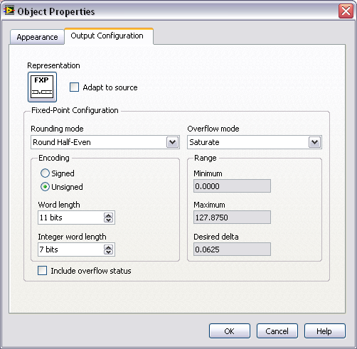
Configuring Fixed Point Functions
Adapt to Source
Rounding Mode
Overflow Mode
Notes:
Functions that support the fixed-point data type include modes to handle rounding and overflow. Use the Properties dialog box for the function to select the overflow and rounding modes. Right-click a function and select Properties from the shortcut menu to display the Properties dialog box.
Adapt to Source–Sets whether the configuration settings for the output value adapt to the input values you wire to the function. For fixed-point data, LabVIEW automatically sets the Fixed-Point Configuration settings to avoid data loss, if possible.
Rounding Mode–Determines how the function handles quantization conditions.
Overflow Mode–Determines how the function handles overflow conditions.

Slide 34
Rounding
Rounding Mode
Truncate
Round Half-Up
Round Half-Even (default)
Rounding – occurs when the precision of the input value or the result of an operation is greater than the precision of the output type.
Notes:
Rounding Mode:
Truncate—Removes fractional bits and therefore does not require any additional hardware resources. However, this mode produces the largest mean error for most data streams. This mode is the default for integer operations.
Round Half-Up—Rounds the value to the nearest value that the output type can represent. If the value lies directly between two such values, LabVIEW rounds to the higher of the two by adding half a least significant bit to the value and then truncating. This method has a higher impact on performance than the Truncate method, but produces a more accurate result.
Round Half-Even—Rounds the value to the nearest value that the output type can represent. If the value lies exactly between two such values, LabVIEW checks the value of the bit that becomes the least significant bit after rounding. If the bit is zero, then LabVIEW rounds to the lower of the two valid values, otherwise it rounds to the higher value. This mode has the highest impact on performance, but it is more accurate than the Truncate method and it eliminates the bias toward the higher value that can occur when you perform multiple Round Half-Up operations. This is the default option.
Overflow Mode
Wrap—Discard significant bits of the output value until it falls within the specified range.
Saturate—Coerce the output value to the maximum or the minimum, depending on which value was exceeded. This option has a higher impact on performance than the Wrap method. This is the default option.

Slide 35
Overflow
Overflow Mode
Wrap
Saturate (default)
Overflow – occurs when the result of an operation is outside the range of values that the output type can represent
Notes:
Rounding Mode:
Truncate—Removes fractional bits and therefore does not require any additional hardware resources. However, this mode produces the largest mean error for most data streams. This mode is the default for integer operations.
Round Half-Up—Rounds the value to the nearest value that the output type can represent. If the value lies directly between two such values, LabVIEW rounds to the higher of the two by adding half a least significant bit to the value and then truncating. This method has a higher impact on performance than the Truncate method, but produces a more accurate result.
Round Half-Even—Rounds the value to the nearest value that the output type can represent. If the value lies exactly between two such values, LabVIEW checks the value of the bit that becomes the least significant bit after rounding. If the bit is zero, then LabVIEW rounds to the lower of the two valid values, otherwise it rounds to the higher value. This mode has the highest impact on performance, but it is more accurate than the Truncate method and it eliminates the bias toward the higher value that can occur when you perform multiple Round Half-Up operations. This is the default option.
Overflow Mode
Wrap—Discard significant bits of the output value until it falls within the specified range.
Saturate—Coerce the output value to the maximum or the minimum, depending on which value was exceeded. This option has a higher impact on performance than the Wrap method. This is the default option.

Slide 36
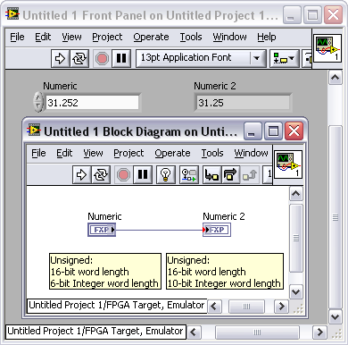
Selecting an Overflow and Rounding Mode
Use same format for all related functions
Mixing fixed-point configuration types can cause data loss
Configure math functions to handle saturation, truncation, and rounding as needed

Slide 37
Exercise 4-2: CompactRIO I/O
Use I/O in LabVIEW FPGA to acquire analog thermocouple data from two channels of an NI 9211 module. Find the difference in the values returned by these two channels.
Notes:
Prep discussion:
The students will perform a similar task to the one that they performed in Exercise 4-1, this time using the CompactRIO chassis.
They will acquire real-world data from two thermocouples connected to the NI 9211.
This time they will be working with the fixed-point data type.
They will calculate the difference between the two thermocouple signals.
Have the students note the data type of the fixed-point data acquired from the NI 9211 and the data type of the output.

Slide 38
Exercise 4-2: CompactRIO I/O
If you wanted to convert the thermocouple data into Fahrenheit or Centigrade, where should that conversion take place?
What was the data type of Thermocouple Difference? Does the data type match what you expected it to be based on the inputs?
Notes:
Temperature conversion should take place on the host computer (RT or Windows). We will discuss how to pass data between the FPGA target and a host VI in Lesson 8.
Ask the students if they remember how subtraction affects the data type. <±, A, B> - <±, A, B> = <±, A+1, B+1>. The inputs were of the type <±, 24, -2>, so the students should report that they saw a data type of <±, 25, -1>.
The students may not understand how the integer word length can be negative. It may be worth taking a minute at the whiteboard and showing. E.g., show them that <±, 6, -2> would result in 0.00XXXXXX, where the X’s represent data stored in the 6-bit word.
Integer word length: The number of integer bits in the bit string that LabVIEW uses to represent all possible values of the fixed-point data, or, given an initial position to the left or right of the most significant bit, the number of bits to shift the binary point to reach the most significant bit. The integer word length can be larger than the word length, and can be positive or negative.

Slide 39
F. CompactRIO
Different modules can have different
Fixed-point configurations
FPGA I/O Methods
FPGA I/O Properties
Timing
Refer to the LabVIEW Help for module-specific information.

Slide 40
Module Data Types
Different modules return fixed-point data with different configurations
Based on accuracy and range of module values
Some I/O nodes return scaled and calibrated fixed-point values

Slide 41
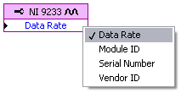



Module Properties and Methods
Different modules have different properties and methods. These are two examples:

Slide 42
Module Timing
Timing is module-specific
NI 9211 (Thermocouple) – single samples
NI 9233 (Analog Input) – multiple samples at user specified rate using the data rate property

Slide 43
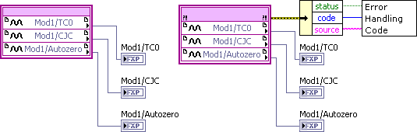
G. Error Handling
Right-click the I/O Node to show error terminals
Error information is useful for debugging and validating data, and is essential in some cases, but it uses space on the FPGA and can slow execution

Slide 44
Error Cluster Optimization
When FPGA resources are limited
Use sequence structures for data flow instead
Show error terminals only for modules whose functions are critical to system operation
Show terminals only once per module if multiple calls are made to the module
Do not pass error clusters through program or display the error cluster on the front panel
Unbundle the source and/or code items and handle the errors immediately.
Notes:
Showing error terminals and processing errors uses FPGA resources.
When resources are tight:
Use sequence structures for data flow. This has minimal cost on the FPGA.
Show error terminals only for modules whose functions are critical to system operation.
Show terminals only once per module if multiple calls are made to the module. The exception to this rule is for modules that have specific errors. Checking once allows you to check for general errors.
Do not pass error clusters through the program or display the error cluster on the front panel.
Unbundle the source and/or code items and handle the errors immediately.

Slide 45
Error Clusters for Reliability
Examples of FPGA I/O errors that need to be handled
Any safety-critical operations
Module-specific error codes for different CompactRIO modules
Examples
File not found (NI 9802)
Timeout (CAN modules)
Module has been removed or is not secure
Notes:
Refer to CompactRIO Error Codes (FPGA Interface) in the LabVIEW Help for more information regarding module-specific errors.
Checking for errors once-per-module is sufficient for most applications

Slide 46
Summary—Quiz
Match each FPGA I/O term to the definition that best fits it.
Terminal
I/O Resource
I/O Name
A name assigned by the developer to a particular I/O resource
A hardware connection, such as on a CompactRIO module
A logical representation in LabVIEW FPGA of a terminal

Slide 47
Summary—Quiz Answers
Match each FPGA I/O term to the definition that best fits it.
Terminal
I/O Resource
I/O Name
A name assigned by the developer to a particular I/O resource
A hardware connection, such as on a CompactRIO module
A logical representation in LabVIEW FPGA of a terminal
Notes:
Terminal – B. A hardware connection, such as on a CompactRIO module
I/O Resource – C. A logical representation in LabVIEW FPGA of a terminal
I/O Name – A. A name assigned by the developer to a particular I/O Resource

Slide 48
Summary—Quiz
What is the default data type of the result of adding two signed fixed-point numbers with a word length of 20 and an integer word length of 10?
<±,40,20>
<+,20,10>
<±,21,11>
<+,30,30>

Slide 49
Summary—Quiz Answer
What is the default data type of the result of adding two signed fixed-point numbers with a word length of 20 and an integer word length of 10?
<±,40,20>
<+,20,10>
<±,21,11>
<+,30,30>
Notes:
Answer: C. <±,21,11>. Since the inputs have the same data type, the integer word length and word length are each increased by one.
Answer A would have been correct if the values were being multiplied.

Slide 50
Summary—Quiz
Which of the following are parameters used to define the range of values that are represented by a fixed-point number?
Terminal
Sign Encoding
Word Length
Integer Word Length

Slide 51
Summary—Quiz Answer
Which of the following are parameters used to define the range of values that are represented by a fixed-point number?
Terminal
Sign Encoding
Word Length
Integer Word Length
Notes:
Answer: B, C, and D. The Sign encoding determines whether the value is signed or unsigned. Word length determines the number of bits used to represent the number. Integer word length determines the number of bits used to represent the integer portion of the number.

Slide 52
Summary—Quiz
Match each analog I/O device to its default data type.
NI PCI-7831R R Series board
NI 9233 CompactRIO module
Integer
Fixed-point

Slide 53
Summary—Quiz Answer
Match each analog I/O device to its default data type.
NI PCI-7831R R Series board
NI 9233 CompactRIO module
Integer
Fixed-point
Notes:
6. NI PCI-7831 R Series Board – A. Integer
7. NI 9233 CompactRIO Module – B. Fixed-point
CompactRIO modules can be configured to return integer data instead, but the default data type is fixed-point. The fixed-point configuration will depend on the module being used.

